Slide 1
Operators

Slide 2
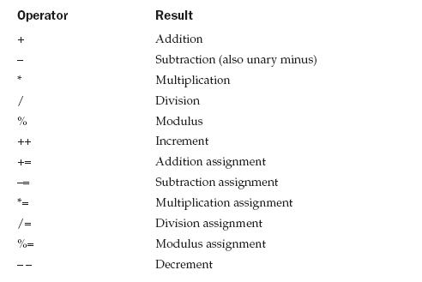
Arithmetic Operators

Slide 3
class BasicMath {
public static void main(String args[]) {
// arithmetic using integers
System.out.println("Integer Arithmetic");
int a = 1 + 1;
int b = a * 3;
int c = b / 4;
int d = c - a;
int e = -d;
System.out.println("a = " + a);
System.out.println("b = " + b);
System.out.println("c = " + c);
System.out.println("d = " + d);
System.out.println("e = " + e);
// arithmetic using doubles
System.out.println("\nFloating Point Arithmetic");
double da = 1 + 1;
double db = da * 3;
double dc = db / 4;
double dd = dc - a;
double de = -dd;
System.out.println("da = " + da);
System.out.println("db = " + db);
System.out.println("dc = " + dc);
System.out.println("dd = " + dd);
System.out.println("de = " + de);
}
}

Slide 4
The modulus operator, %, returns the remainder of a division operation
It can be applied to floating-point types as well as integer types
This differs from C/C++, in which the % can only be applied to integer types

Slide 5
class Modulus {
public static void main(String args[]) {
int x = 42;
double y = 42.25;
System.out.println("x mod 10 = " + x % 10);
System.out.println("y mod 10 = " + y % 10);
}
}
When you run this program you will get the following output:
x mod 10 = 2
y mod 10 = 2.25

Slide 6
Arithmetic Assignment Operators
a = a + 4;
a += 4;
Any statement of the form
var = var op expression;
can be rewritten as
var op= expression;

Slide 7
Increment and decrement op’s
Similar to C++

Slide 8
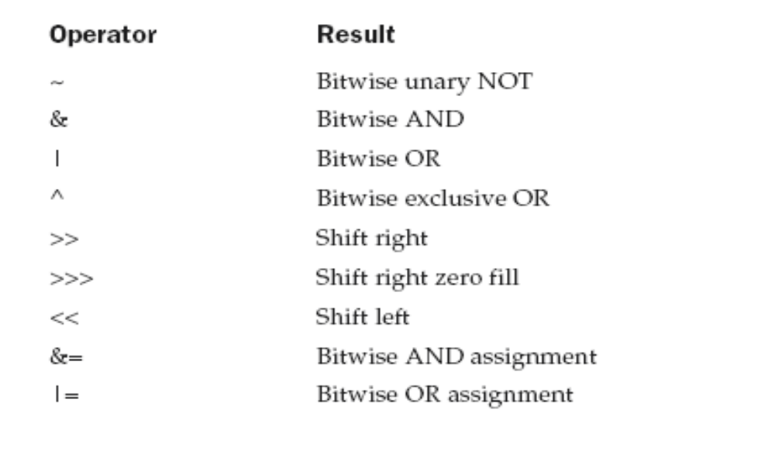
The Bitwise Operators

Slide 9
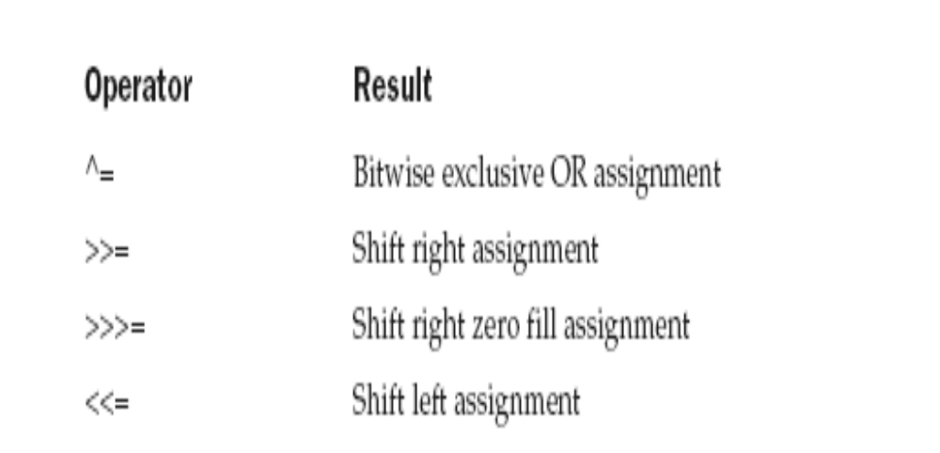

Slide 10
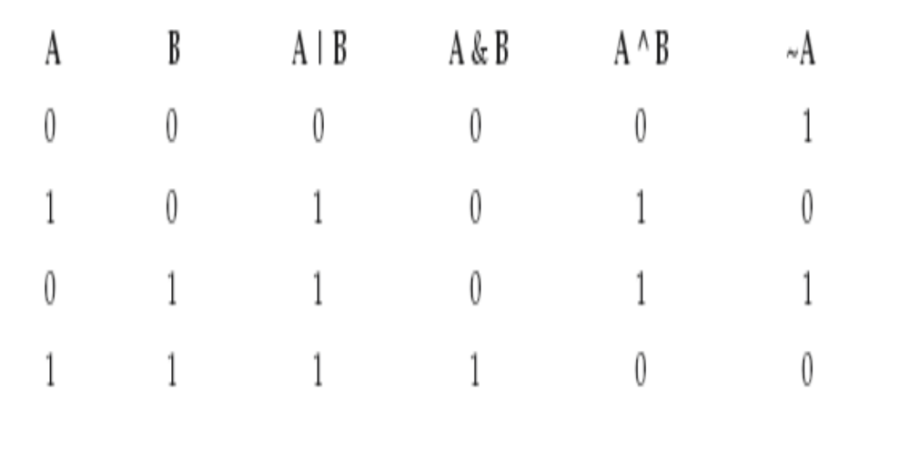

Slide 11
class BitLogic {
public static void main(String args[]) {
String binary[ ] = {
"0000", "0001", "0010", "0011", "0100", "0101", "0110", "0111",
"1000", "1001", "1010", "1011", "1100", "1101", "1110", "1111"
};
int a = 3; // 0 + 2 + 1 or 0011 in binary
int b = 6; // 4 + 2 + 0 or 0110 in binary
int c = a | b;
int d = a & b;
int e = a ^ b;
int f = (~a & b) | (a & ~b);
int g = ~a & 0x0f;
System.out.println(" a = " + binary[a]);
System.out.println(" b = " + binary[b]);
System.out.println(" a|b = " + binary[c]);
System.out.println(" a&b = " + binary[d]);
System.out.println(" a^b = " + binary[e]);
System.out.println("~a&b|a&~b = " + binary[f]);
System.out.println(" ~a = " + binary[g]);
}
}

Slide 12
The Left Shift
It has this general form:
value << num
If you left-shift a byte value, that value will first be promoted to int and then shifted
This means that you must discard the top three bytes of the result if what you want is the result of a shifted byte value
The easiest way to do this is to simply cast the result back into a byte

Slide 13
class ByteShift {
public static void main(String args[]) {
byte a = 64, b;
int i;
i = a << 2;
b = (byte) (a << 2);
System.out.println("Original value of a: " + a);
System.out.println("i and b: " + i + " " + b);
}
}
Output:
Original value of a: 64
i and b: 256 0

Slide 14
The Right Shift
The right shift operator, >>, shifts all of the bits in a value to the right a specified number of times
value >> num
int a = 32;
a = a >> 2; // a now contains 8
int a = 35;
a = a >> 2; // a still contains 8

Slide 15
11111000 –8
>>1
11111100 –4
Sign extension

Slide 16
// Masking sign extension.
class HexByte {
static public void main(String args[]) {
char hex[] = {
'0', '1', '2', '3', '4', '5', '6', '7',
'8', '9', 'a', 'b', 'c', 'd', 'e', 'f'
};
byte b = (byte) 0xf1;
System.out.println("b = 0x" + hex[(b >> 4) & 0x0f] + hex[b & 0x0f]);
}
}

Slide 17
The Unsigned Right Shift
Unsigned, shift-right operator, >>>, which always shifts zeros into the high-order bit
int a = -1;
a = a >>> 24;
Here is the same operation in binary form to further illustrate what is happening:
11111111 11111111 11111111 11111111 –1 in binary as an int
>>>24
00000000 00000000 00000000 11111111 255 in binary as an int

Slide 18
// Unsigned shifting a byte value.
class ByteUShift {
static public void main(String args[]) {
char hex[] = {
'0', '1', '2', '3', '4', '5', '6', '7',
'8', '9', 'a', 'b', 'c', 'd', 'e', 'f'
};
byte b = (byte) 0xf1;
byte c = (byte) (b >> 4);
byte d = (byte) (b >>> 4);
byte e = (byte) ((b & 0xff) >> 4);
System.out.println(" b = 0x“ + hex[(b >> 4) & 0x0f] + hex[b & 0x0f]);
System.out.println(" b >> 4 = 0x“ + hex[(c >> 4) & 0x0f] + hex[c & 0x0f]);
System.out.println(" b >>> 4 = 0x“ + hex[(d >> 4) & 0x0f] + hex[d & 0x0f]);
System.out.println("(b & 0xff) >> 4 = 0x“ + hex[(e >> 4) & 0x0f] + hex[e & 0x0f]);
}
}

Slide 19
Output
  b = 0xf1
  b >> 4 = 0xff
  b >>> 4 = 0xff
  (b & 0xff) >> 4 = 0x0f

Slide 20
Bitwise Operator Assignments
a = a >> 4;
a >>= 4;
a = a | b;
a |= b;

Slide 21
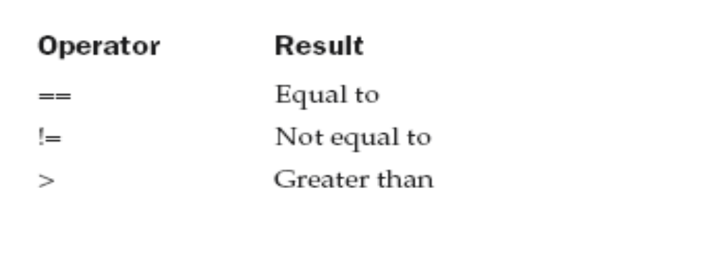
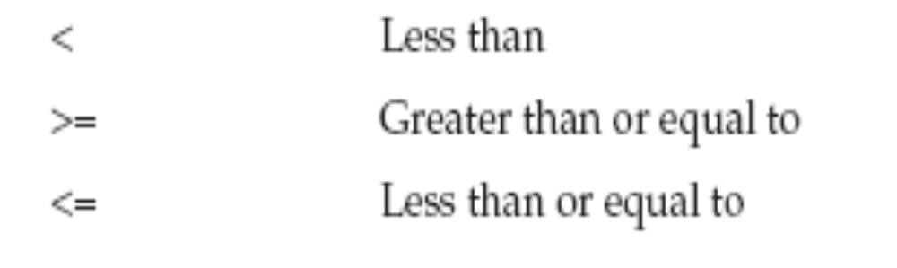
Relational Operators

Slide 22
int a = 4;
int b = 1;
boolean c = a < b;
int done;
// ...
if(!done) ... // Valid in C/C++
if(done) ... // but not in Java.
In Java, these statements must be written like this:
if(done == 0)) ... // This is Java-style.
if(done != 0) ...

Slide 23
In Java, true and false are nonnumeric values which do not relate to zero or nonzero

Slide 24
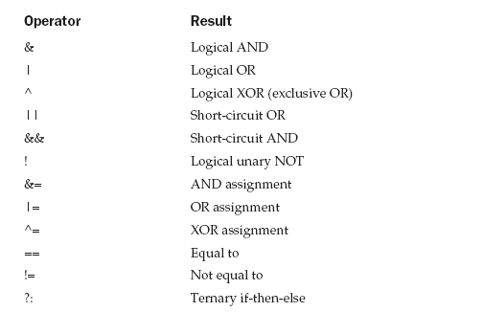
Boolean Logical Operators

Slide 25
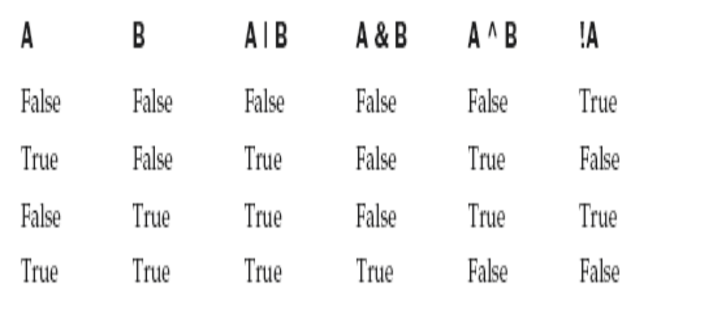

Slide 26
Short-Circuit Logical Operators
Java will not bother to evaluate the right-hand operand when the outcome of the expression can be determined by the left operand alone
Example 1:
if (denom != 0 && num / denom > 10)
Example 2:
if(c==1 & e++ < 100) d = 100;

Slide 27
The Assignment Operator
var = expression;
int x, y, z;
x = y = z = 100; // set x, y, and z to 100

Slide 28
The ? Operator
expression1 ? expression2 : expression3
Example:
ratio = denom == 0 ? 0 : num / denom;

Slide 29
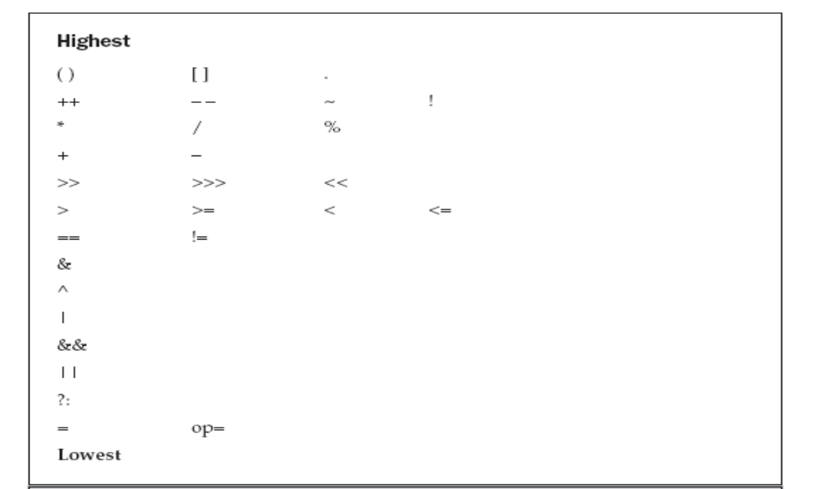
Operator Precedence

Slide 30
Example:
a | 4 + c >> b & 7
(a | (((4 + c) >> b) & 7))

Slide 31
Parentheses (redundant or not) do not degrade the performance of your program
Therefore, adding parentheses to reduce ambiguity does not negatively affect your program

